Slide 1
Calculating the mode
Task A: Mode from a frequency table
What is the mode for each frequency table? If there is no mode, write no mode.
Animal | Frequency
cat | 24
dog | 18
fish | 11
rabbit | 15
Goals | Frequency
0 | 16
1 | 24
2 | 24
3 | 19
Score | Frequency
1 | 12
2 | 12
3 | 12
4 | 12
A data set of 50 is represented on this frequency table.
Fill in the missing frequency and write down the mode number of goals scored.
Goals | Frequency
0 | 9
1
2 | 11
3 | 21

Slide 2
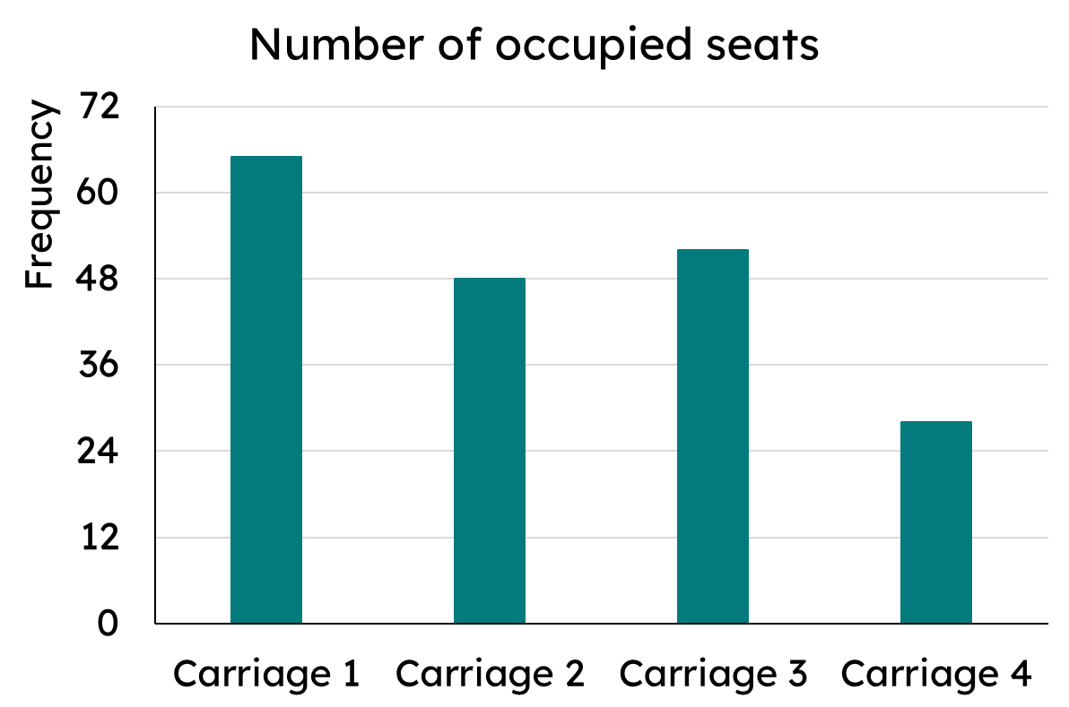
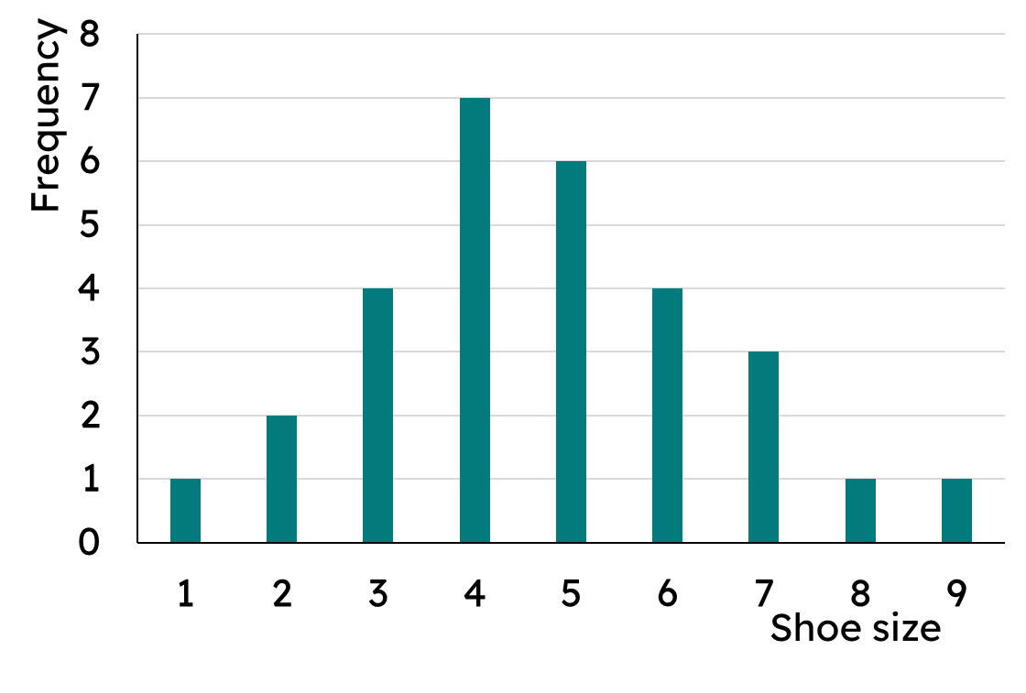
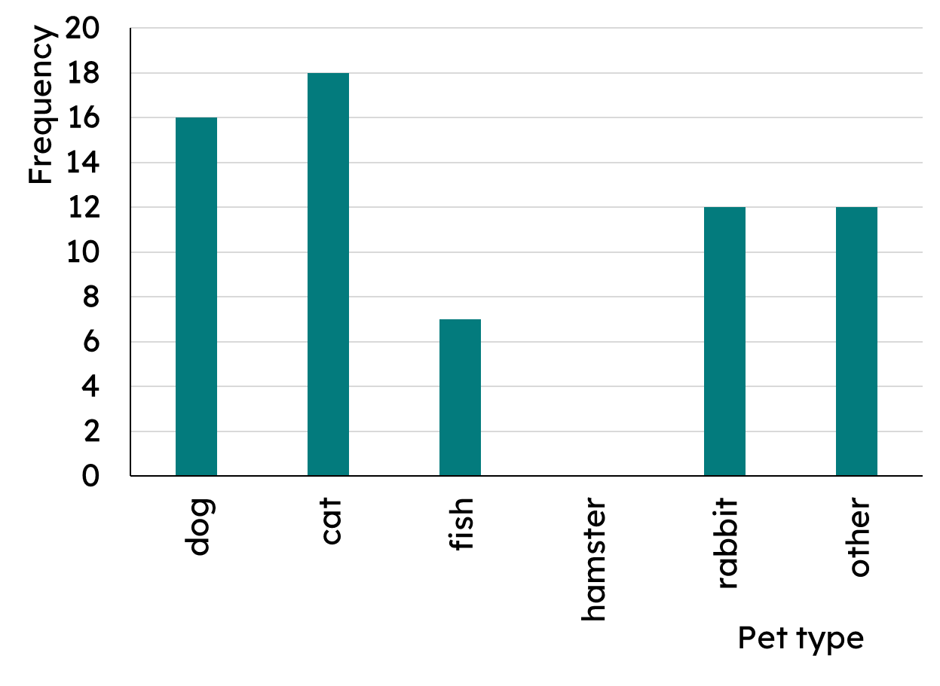
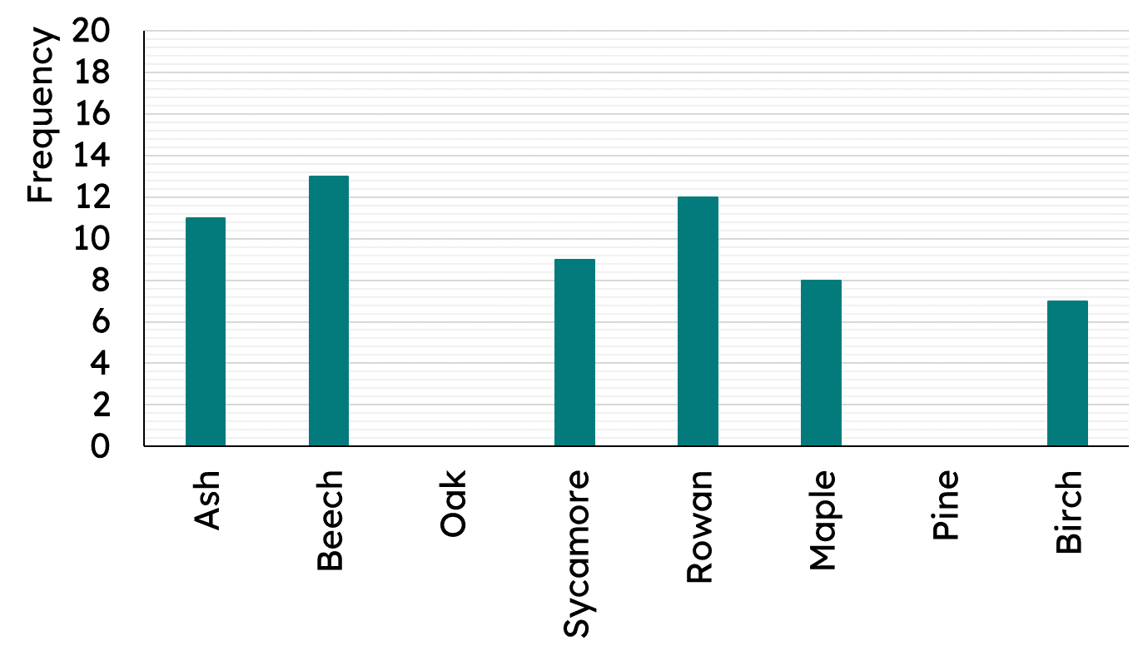
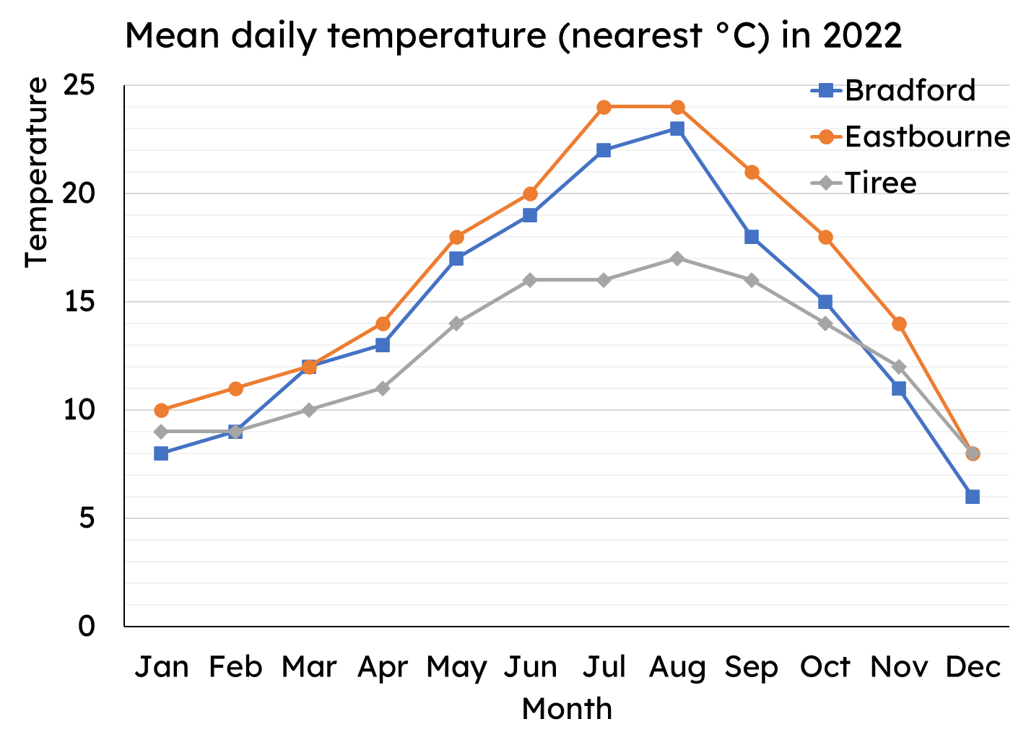
Calculating the mode
Task B: Mode from bar charts
What is the mode on each of these bar charts?
a)
b)
The data is bimodal. Complete the bar chart.
100 pieces of data are represented on a bar chart. The data is bimodal. Add the two missing bars.
Task C: Mode from line graphs
What is the modal temperature for each place?
Mathematics In Education and Industry
v2.1

